Slide 1
MTVT – Mid Project Review
Cassette Costen

Slide 2
Project Goals Recap
Isosurface extraction
Primarily for procedural noise functions
Near-realtime performance
Minimal triangle count
Even triangles
Modular (chunks)
Compare tesselation schemes
Compare merging/regularisation methods
Triangle quality
Performance

Slide 3
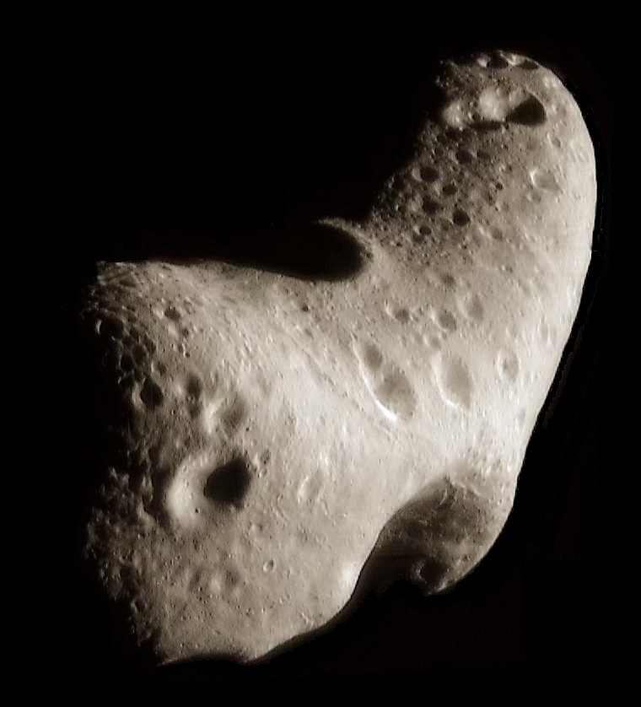
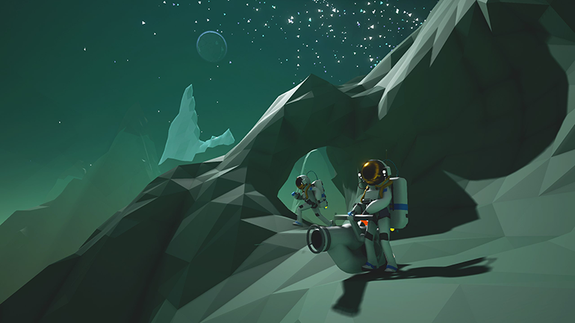
ASTRONEER (from developer interview with Epic Games)
433 Eros (from Wikipedia, image origin https://photojournal.jpl.nasa.gov/catalog/PIA02923)

Slide 4
Key research paper:
Treece, Prager, and Gee (1999) – Regularised Marching Tetrahedra
there are some basics first though

Slide 5
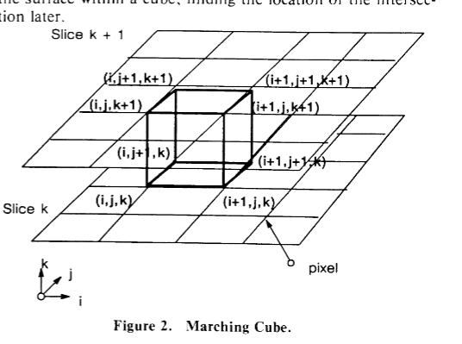
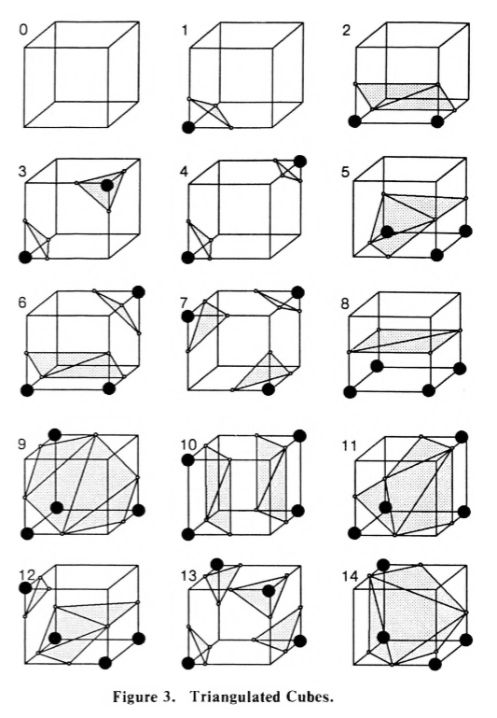
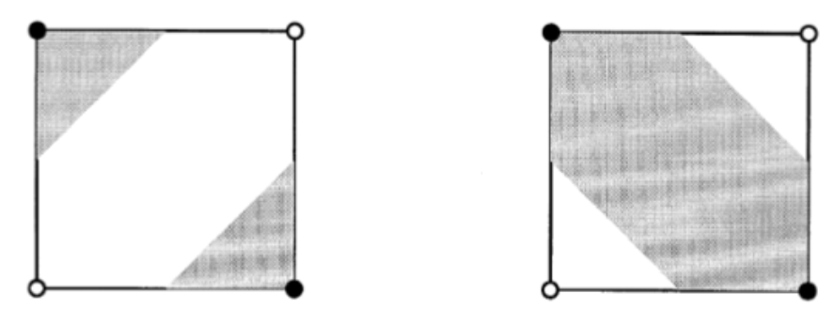
marching cubes
divide and conquer
has issues with ambiguity
lots of configurations
makes lots of tiny/elongated triangles
diagrams sourced from Lorensen and Cline (1987)
except this one is from Chan and Purisma (1998)

Slide 6
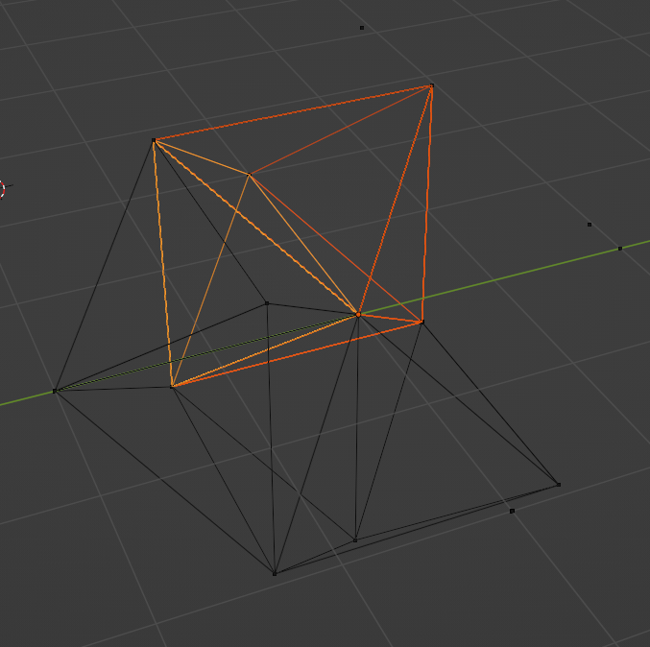
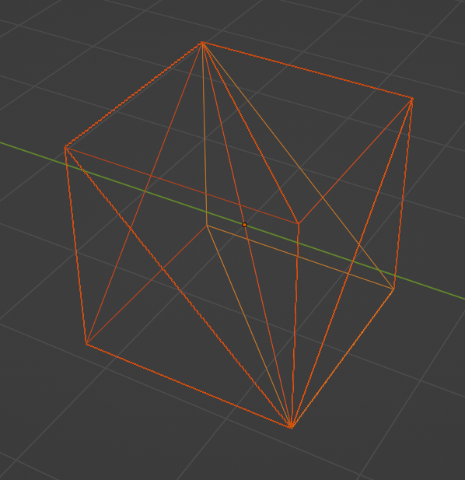
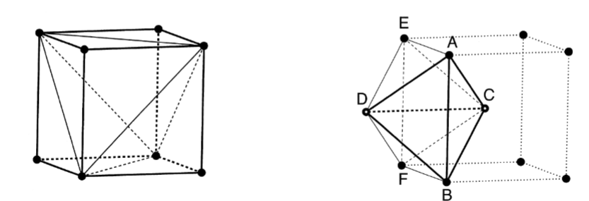
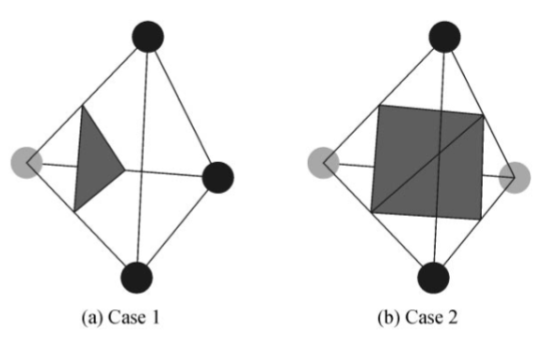
marching tetrahedra
tetrahedra instead of cubes
often makes even worse triangles
different tesselations
the body-centric arrangement has a better edge length ratio
only 16 configurations, which reduce to only 2
from Treece, Prager, and Gee (1999)
from Chan and Purisma (1998)

Slide 7
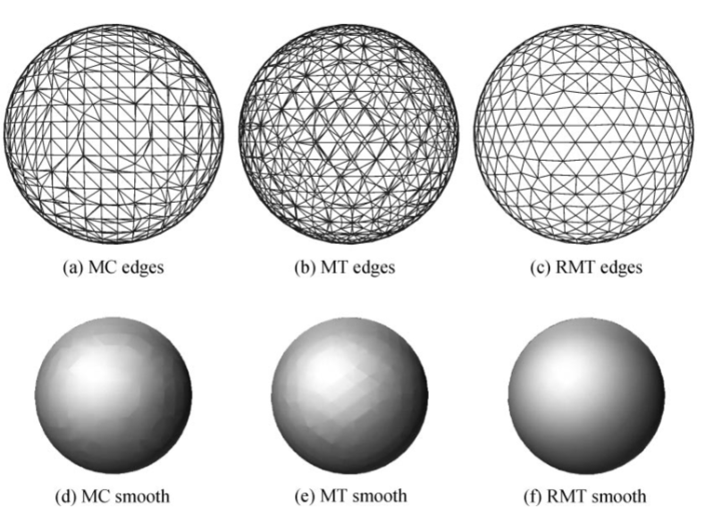
regularised marching tetrahedra
produces regular, even triangles for the most part
preserves topology when merging
results in excellent shading
massively reduced vertex & triangle count (70-80%!!)
from Treece, Prager, and Gee (1999)

Slide 8
other isosurface extraction techniques
adaptive MC – computes different parts of the mesh at higher or lower cube resolution depending on curvature
elastic surface nets – adjusts nodes within individual constraints toward the isosurface but with smoothing relative to neighbours
re-tiling – places points on an existing mesh and repel them from one another, then mutually re-triangulates
multi-labeled RMT – extends RMT for multiple volume zones (not just inside/outside) for geological modelling
Delaunay tetrahedral grids – uses a cloud of sample points (carrying an SDF each) which are joined into tetrahedra, then MT performed
recursively subdivided tetrahedra; tetrahedral grid refinement – similar to MT except the tetrahedra are subdivided as necessary

Slide 9
how RMT actually works (it’s magic)
1. compute value at
each sample point
2. check which connected
SPs have nearby
intersections, and mark them
3. merge intersections where
possible and create
vertices accordingly
4. use stored vertex references
to construct geometry
per-tetrahedron

Slide 10
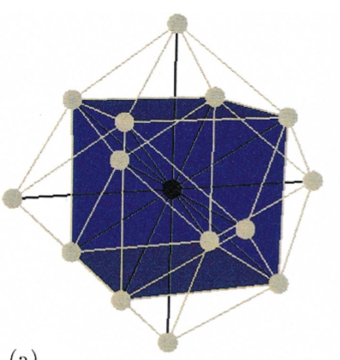
4
threshold = 0.5
0.2
10.6
3
0.5
0
1
are the two values on opposite sides of the threshold? (yes)
which sample point is closer to the threshold? (left)
left gets a bitflag set marking this edge as having a nearby intersection
2
5

Slide 11
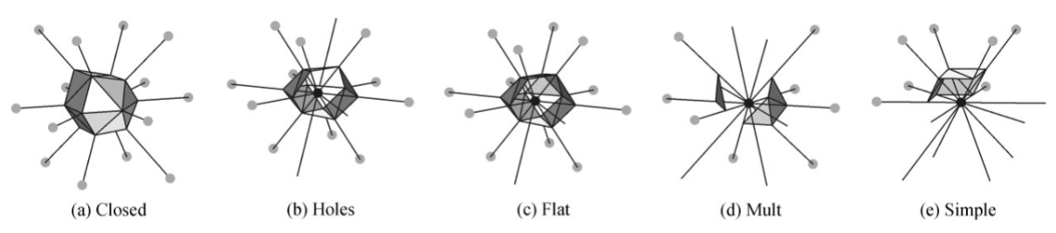
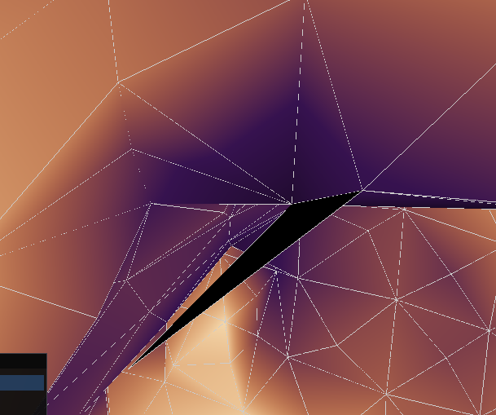
we can’t always merge things! we might ruin the topology and create invalid/non-manifold meshes!

Slide 12
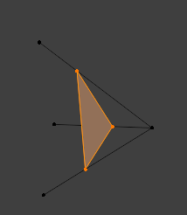
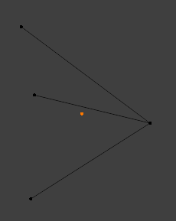
instead of three separate vertices (one for each intersection)
we can merge them into a single vertex (and tell all three edges to
reference the same one)

Slide 13
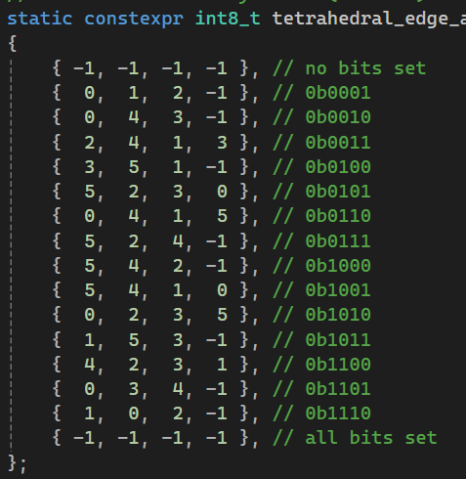
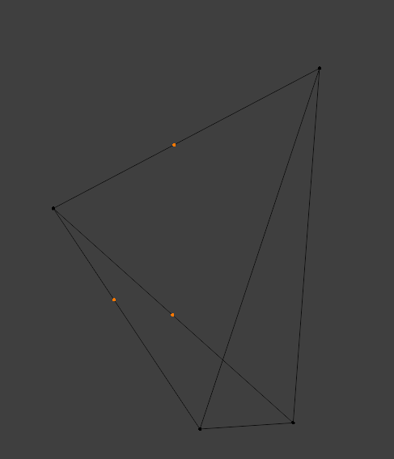
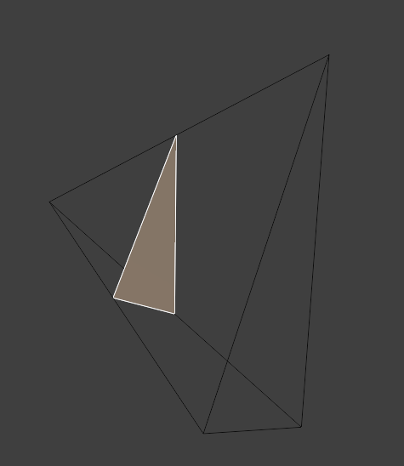
SP 1
edge 0
vert A
SP 0
edge 4
edge 1
edge 3
edge 2
vert C
vert B
edge 5
{ 0, 1, 2 } good
{ 0, 1, 0 } evil
SP 3
SP 2

Slide 14
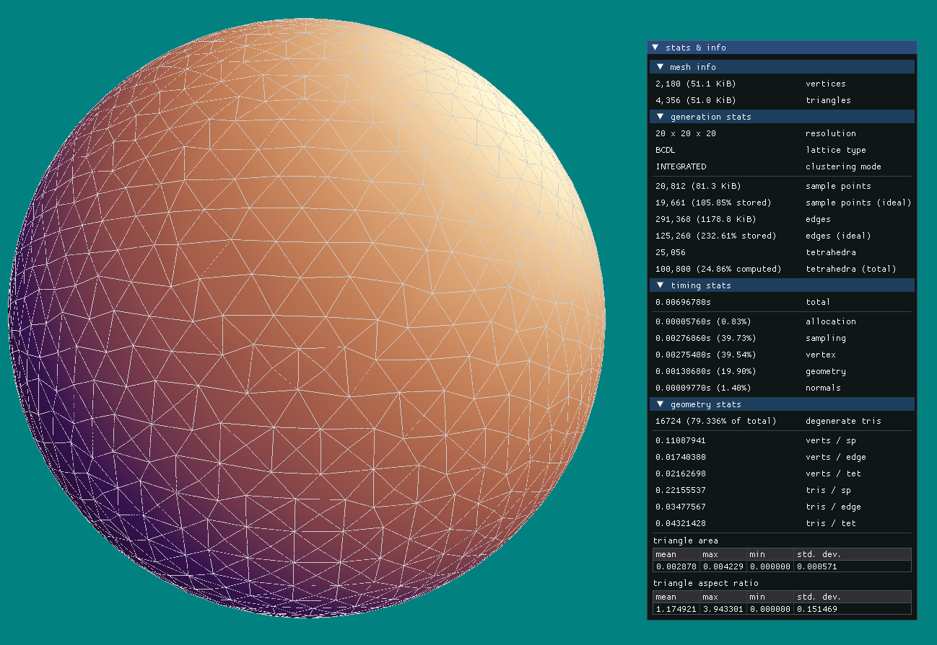

Slide 15
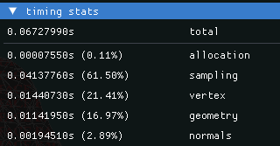
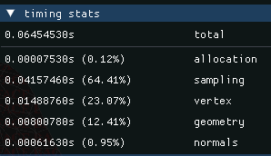
RMT versus just merging stuff afterwards
RMT does duplicate-vertex merging automatically
RMT makes it easy to preserve topology
no O(n^2) distance comparison or ‘build an octree’ required
cost of merging in RMT is almost nothing, since in most cases it can be skipped (and only 14 elements are considered at a time)
no random list access required (makes the cache sad)
no topology/list manipulation required
← in fact, in some benchmarks the algorithm is faster when merging is enabled! since it reduces the cost of the geometry step.

Slide 16
my alterations and optimisations
rearranged passes (sampling, vertex, geometry)
skip 24 tetrahedra at a time using this one simple trick (doctors hate her)
per-edge data storage – doubling the memory for performance reasons
invalid triangles – missing vertex references (it was my fault all along)
new merging algorithm – almost solving the topology maintenance issue with graph theory

Slide 17
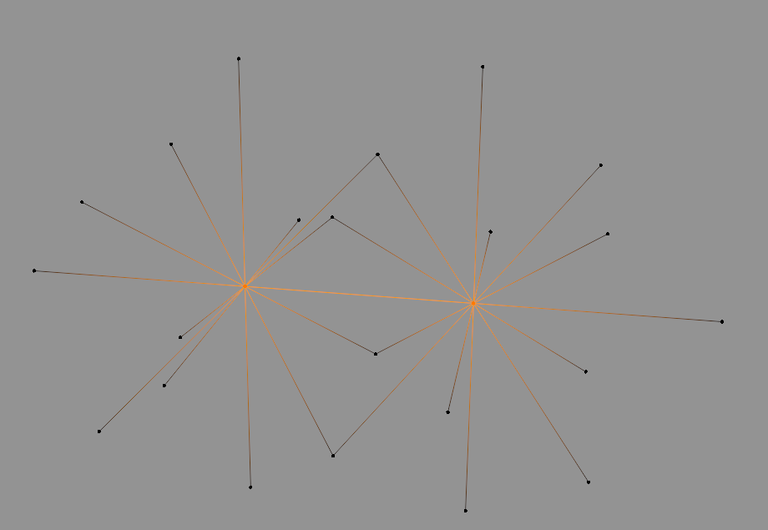
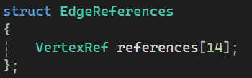
a.references[PX] may store the data
or b.references[NX] may store the data
depending on which (a or b) is closer to the isosurface intersection!

Slide 18
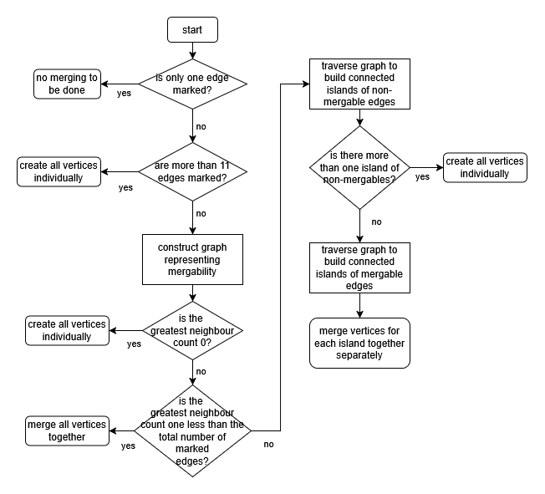

Slide 19
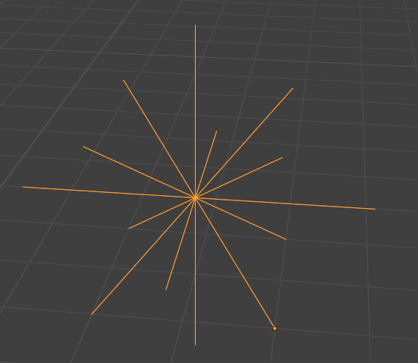
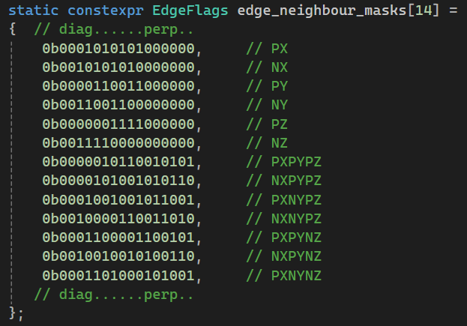
two nodes are connected if they a) are immediate neighbours in the 3D representation and b) both have nearby isosurface intersections
this represents a 14x14 adjacency matrix where a 1 signifies and connection between nodes (aka edges). this template can then be processed with bitwise AND to produce a graph that satisfies both conditions above
each of the 14 edges maps to a node in the graph

Slide 20
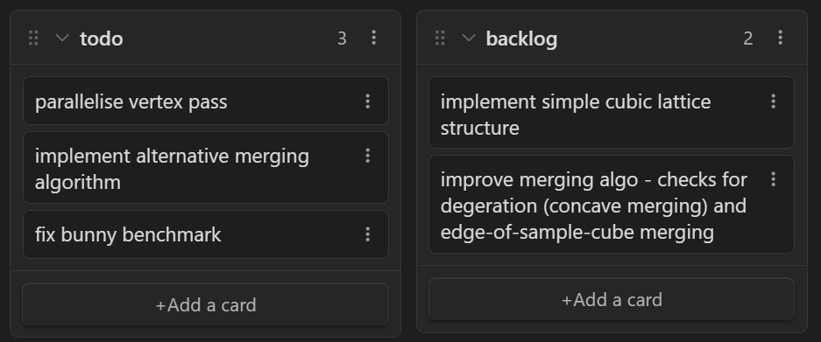
what’s done; what’s left
RMT algorithm implemented
vertex normal generation
multi-benchmarking system including CSV output
capturing of timing, vertex/triangle count, and triangle area & AR statistics
adjustments for chunkability
graphical preview/playground environment

Slide 21
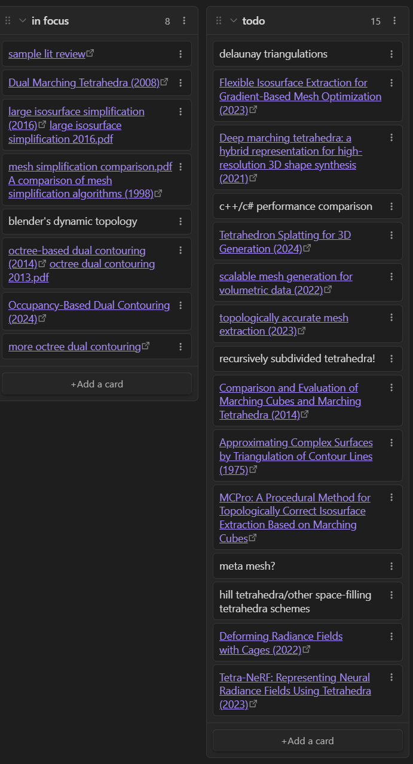
remaining research
mesh simplification/merging algorithms
a bit more isosurface extraction work
some C++ optimisation research
the questionnaire
statistical analysis of benchmarking data

Slide 22
write-up status
literature review as a collection of article summaries (with notes on specific methods as well as what will be useful to mention for my context)
detailed documentation of issues and methods on the forum which will can be used to write formal explanations later (also well documented code!)
source list
already generating and storing benchmark data

Slide 23
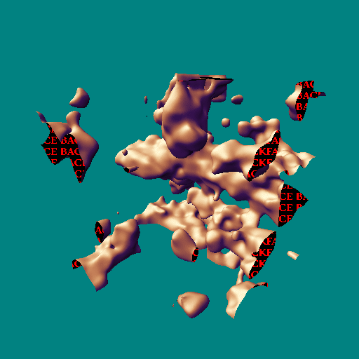
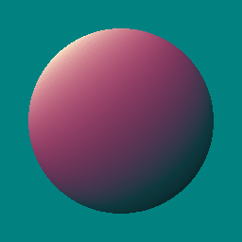
demo time!

